Slide 1
American Express Make-a-thon 2019 ‘Replace the card’ campaign
BLACK WIDOWS
Himanshi Sharma
Manisha Kumari
Kirtika Gupta
Delhi Technological University

Slide 2
Our Interpretation
Problem Statement
How would you like American Express to engage with millennials
and onboard them as American Express card member?
American Express is trying to attract the young, affluent potential cardholders whom it may be losing to other credit card companies.
We can strategize our campaign to capture the current customers of our rivals.

Slide 3
Target Audience
Working class people who are cardholders of other companies, i.e., those who already use credit cards in their daily life.
Why are we targeting customers of our rivals?
We don’t need to convince them to use ‘a’ credit card. They already do so. We just need to convince them to shift to ‘the best’ credit card provider, American Express.
Through our campaign, people will be able to understand how American Express is better than their current credit card providers.
Stealing customers from rivals is always fun, isn’t it?

Slide 4
Characteristics of our solution
To capture the attention of millennials, our campaign must have the following characteristics -
Interactive and Fun – Millennials are readily attracted to cool and fun stuff.
Socially Attractive – Millennials are very active on social media. Anything going popular there will definitely attract them. They even have a fear of missing out on anything new.
Offers and Benefits – Millennials are focused on saving. We can give them the best offers and help them save more through American Express.
Convenient – Millennials look for convenience everywhere. After initial attraction through our campaign, the onboarding process must be made very convenient for them to get onboard.

Slide 5
‘Replace the Card’ Campaign
Visit American Express India app or website
Signup to participate in ‘Replace the Card’ campaign
Point your phone camera to your existing credit card(s)
We will use Augmented Reality to replace it with a brand new AmEx card
We will compare your card to ours and tell you how AmEx can serve you better
It’s not just fun, you also get a free AmEx card with several ‘new user’ benefits
Also get additional benefits for every card you ‘replace’
You can choose the most suitable among the suggested AmEx cards and apply hassle free
We will deliver the card to you and provide you the best experience ever

Slide 6
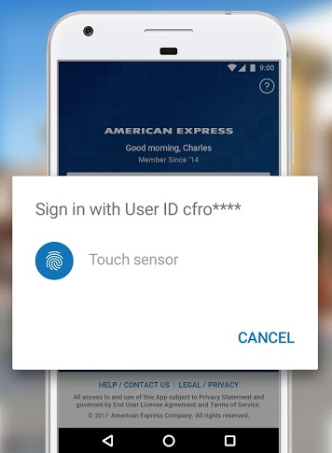
Signup
Visit American Express India app or website
Signup to participate in ‘Replace the Card’ campaign

Slide 7
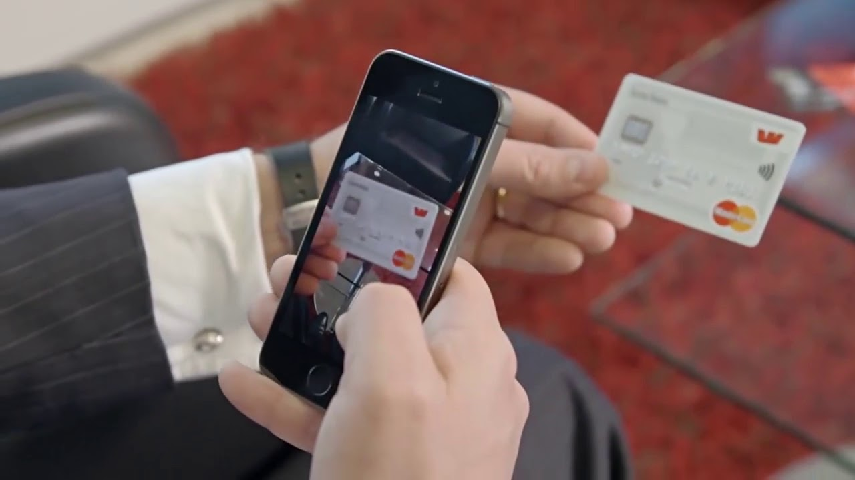
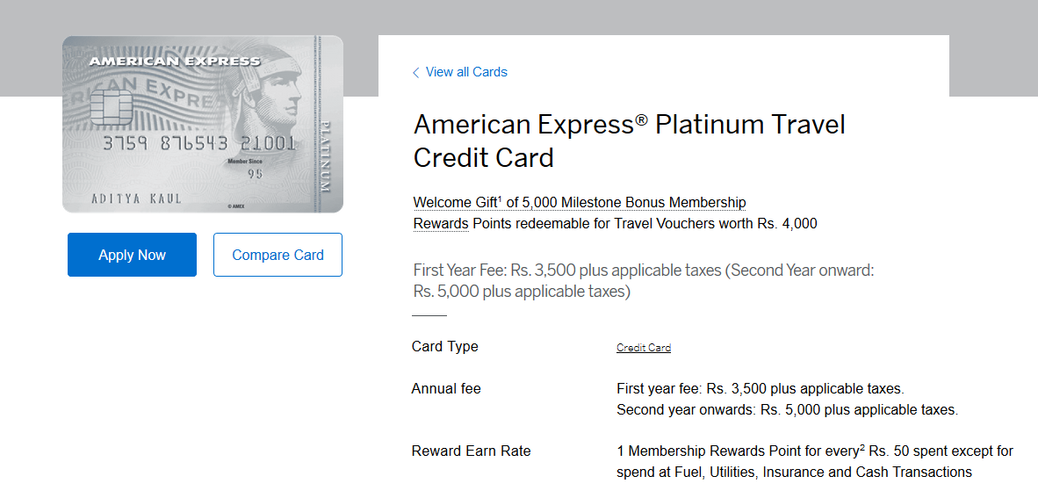
‘Replace the Card’
Point your phone camera to your existing credit card(s)
We will use Augmented Reality to replace it with a brand new AmEx card
We will compare your card to ours and tell you how AmEx can serve you better

Slide 8

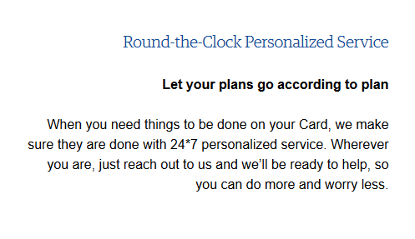
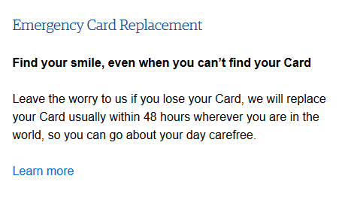
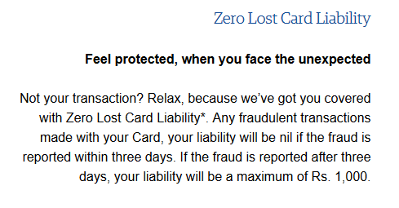
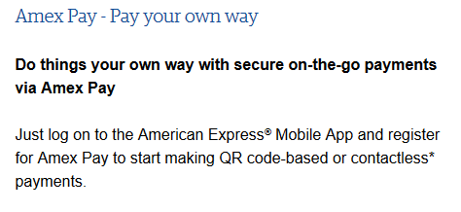
Enjoy Benefits
It’s not just fun, you also get a free AmEx card with several ‘new user’ benefits
Also get additional benefits for every card you ‘replace’

Slide 9
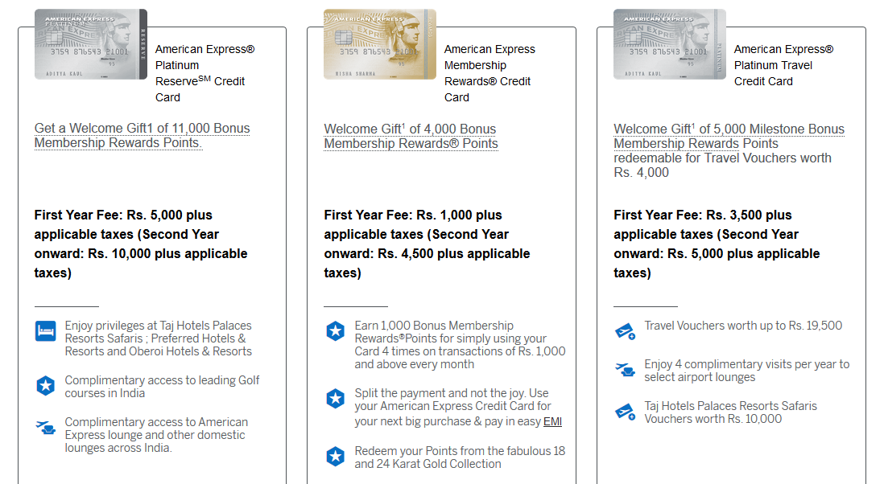
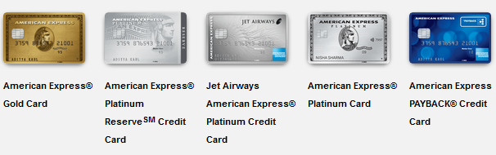
Use AmEx card best suited for you
You can choose the most suitable among the suggested AmEx cards and apply hassle free
We will deliver the card to you and provide you the best experience ever

Slide 10
Perks for American Express
We can capture customers of our competitors using this campaign. We will get such new customers who already use credit cards on daily basis.
We will get useful data that is very crucial for AmEx. We will capture details like who has how many cards of which companies.
In case a customer decides not to shift to AmEx, we can use this data for launching a targeted advertisement campaign for that customer.

Slide 11
Thank You
We are very excited about this idea.
We look forward to working with you and taking this idea to the market for AmEx.
Thank You
Black Widows
Himanshi Sharma (8826465670) (himanshi.sharma0197@gmail.com)
Manisha Kumari
Kirtika Gupta

